Slide 1
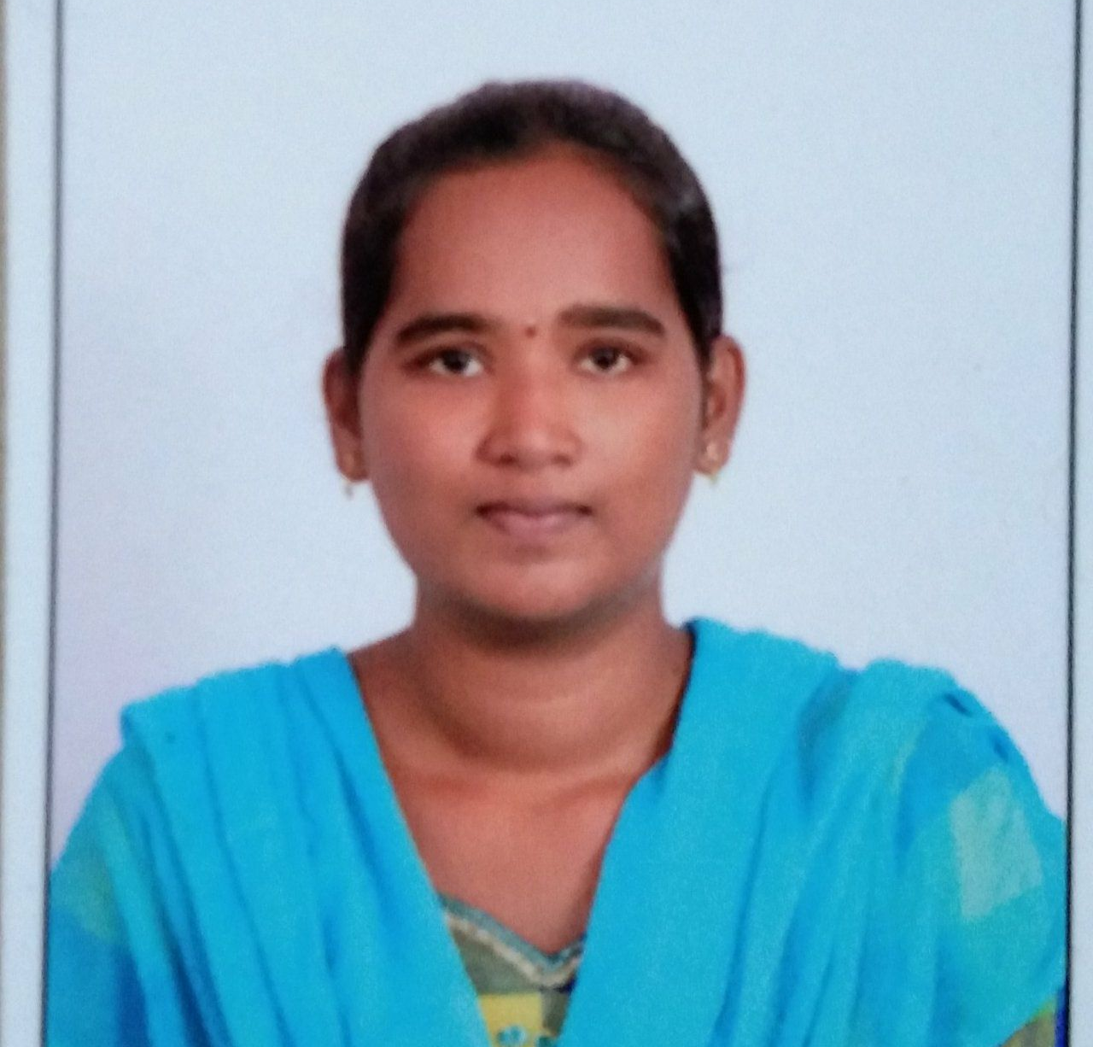



Challapalli Hari Chandana
Analyst/Software Engineer
Master Of Computer Science
Computer Science : 2019 - 2021
Skills
Java 8 /J2EE | Java Basics, OOPS, Generics, Collections, Arrays, Loops, Lambda Exp, Stream API Junit, Mockito.
Spring core | IOC & Dependency Injection, Auto Wiring.
Spring REST | REST controllers, Implementation of GET, POST, PUT & DELETE, Bean Validation & Exception Handling, Testing Services, Controller & Repository layer
Spring Data JPA | Implement DAO layer using spring Data repositories, Transaction Management
Spring Boot Microservices | Spring Boot Starters, annotations, Messaging Service, Sync/Async comms, Swagger API documents
Spring Cloud | Eureka, Hystrix, Zuul & Config Server
React | Components, Hooks, Event handling, Redux, Reducers.
Database | MongoDB
UI Tech | HTML 5 & CSS 3,JavaScript, ES6 & TypeScript Reusable templates, Optimized UI Designed
Tools | Git, Postman, Maven, IDE
Devops | CI/CD, Jenkins configuration, Build Pipelines, notifications, quality gate understanding
Add On skills | Communication skills, Team management. Peer learning
Hyderabad
Challapalli.Hari-chandana@capgemini.com
+91 9390384345
A4
Full Stack Developer
Java Microservices Development knowledge using Spring boot, Spring Cloud API Gateway, Eureka server.
React developer with working knowledge on ReactJS(Components, redux)
Implemented Nodejs in case study and upskilling my knowledge on it.
Experience in creating documentation with Java docs and swagger and in unit testing using Junit, Mockito.
Hands on experience in developing web pages using HTML5,CSS3,Object Oriented Java Script,ES6.
.
Flight Booking System
Completed end to end case study of Flight Booking System Application along with Swagger and Data validation for UI for User login. UI and React used for user interface

